Slide 1


F1 Tracks
Speed, Data, Action: Discover F1 like never before

Slide 2
PART A

Slide 3
General Description
Project aims to develop a comprehensive system for organizing, analysing, and assessing diverse types of multimedia data related to F1 circuits worldwide.
This system will integrate various data forms in order to perform a full experience about F1 information.

Slide 4
TYPES OF DATA

Slide 5
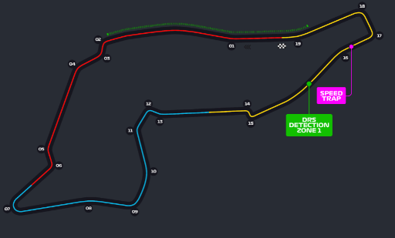
Interactive Images

Slide 6
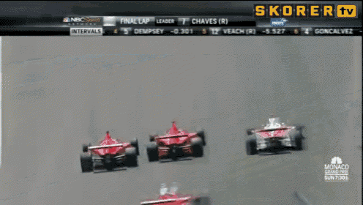
Videos

Slide 7
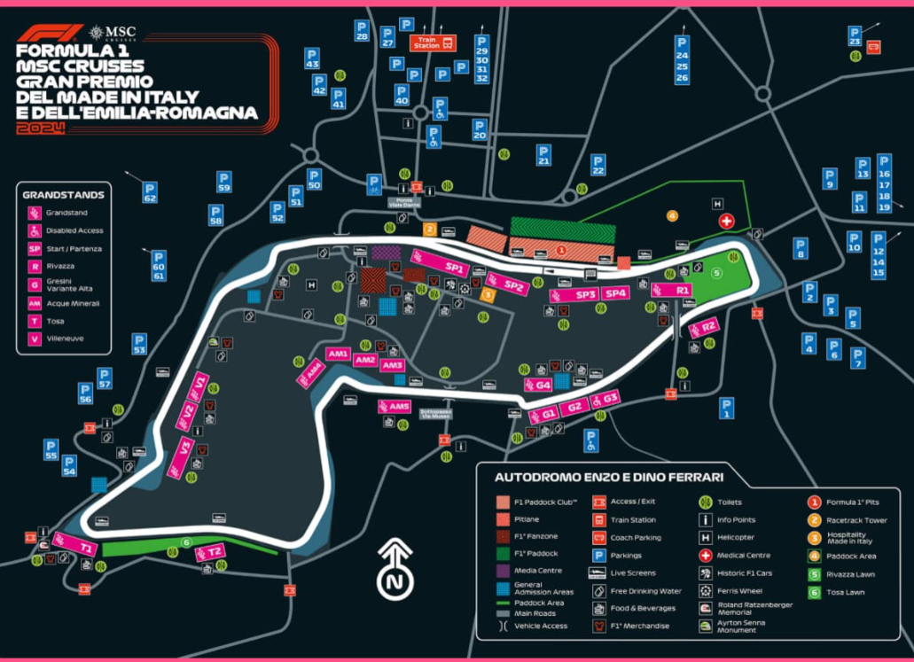
Geolocations

Slide 8
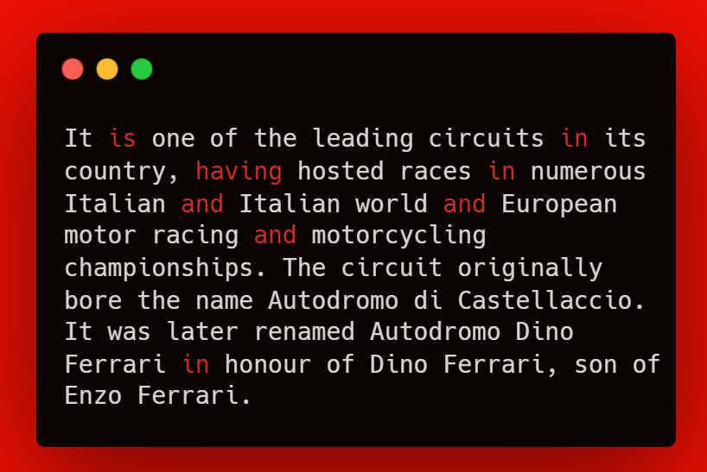
Documents

Slide 9
USE CASES

Slide 10
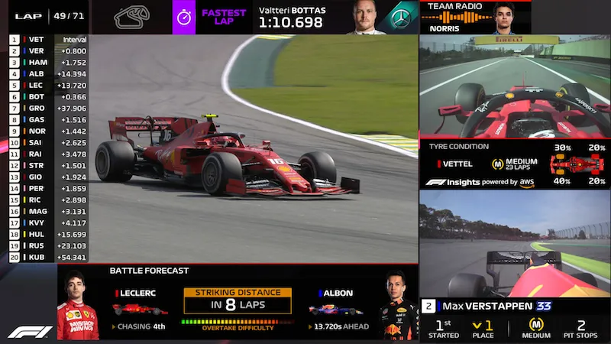
Enhanced Race Viewing Experience

Slide 11
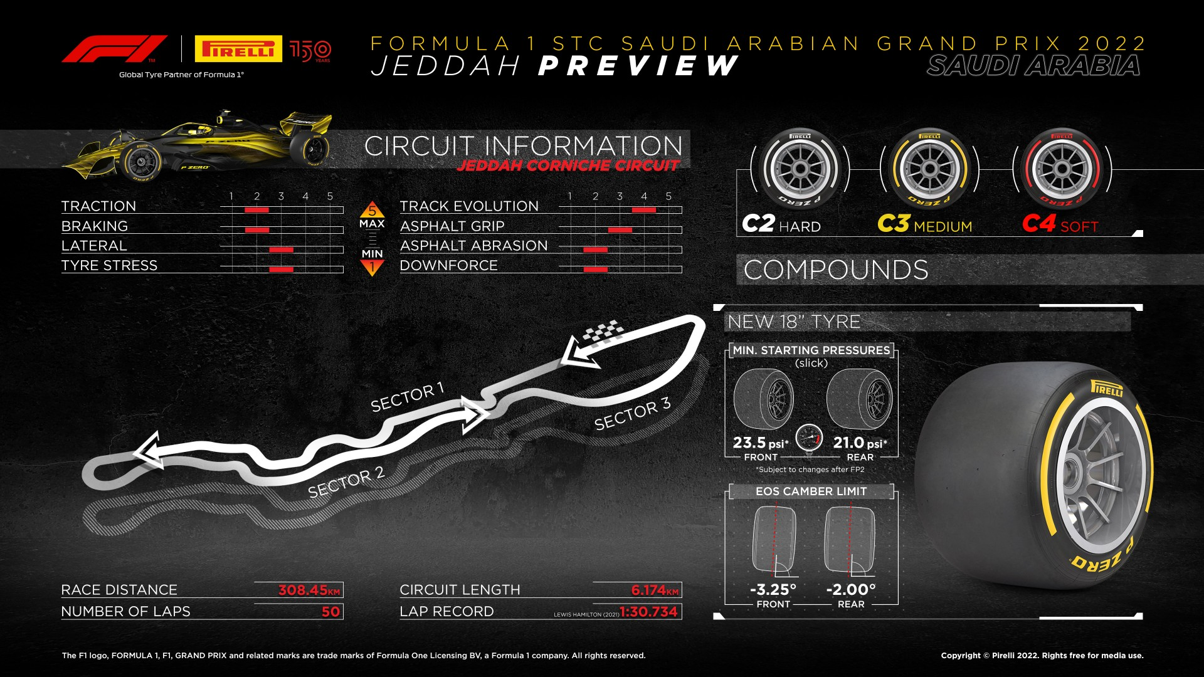
Interactive Information Track Portal

Slide 12
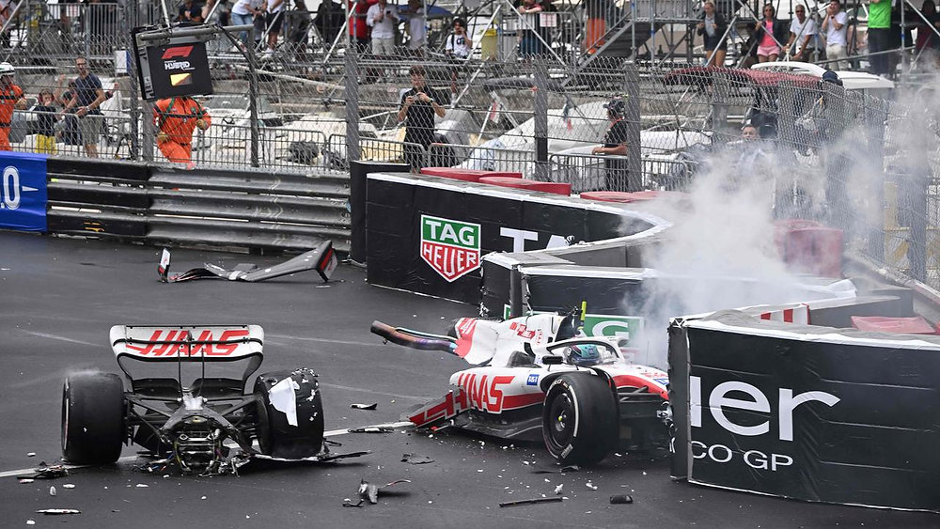
Safety Enhancements

Slide 13
PART B

Slide 14
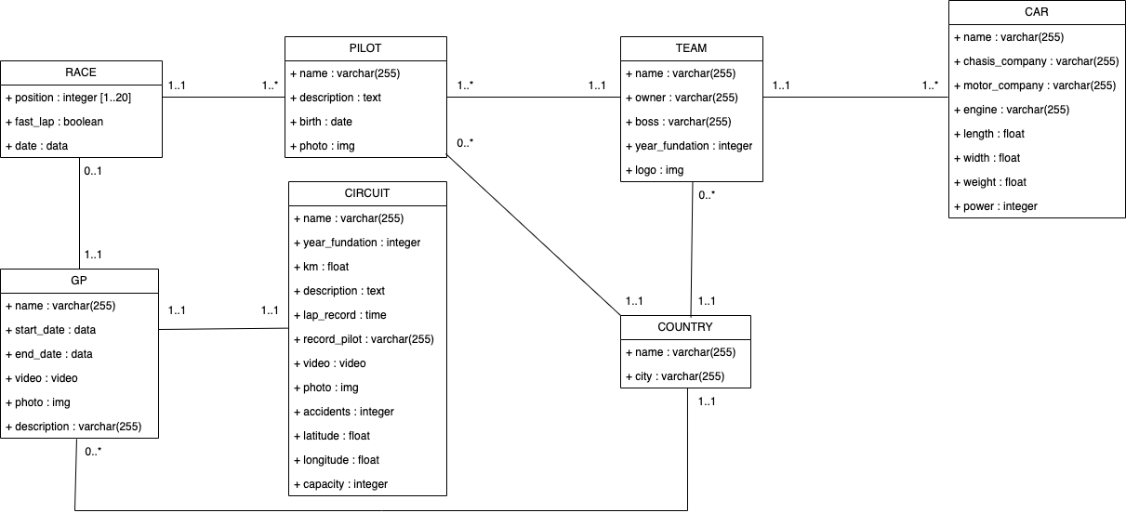
Relational Model

Slide 15
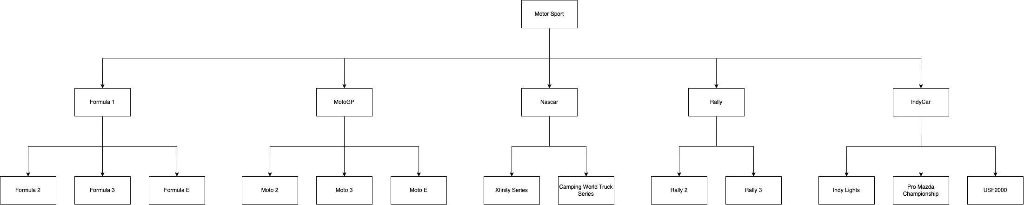
Sports

Slide 16
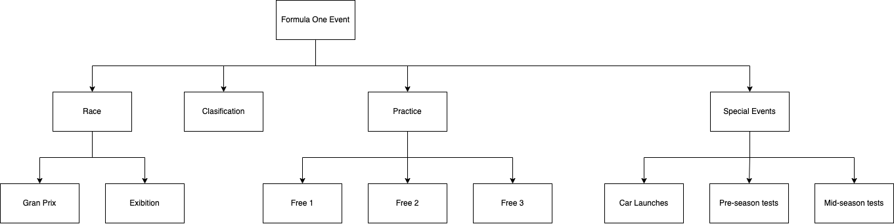
Events

Slide 17
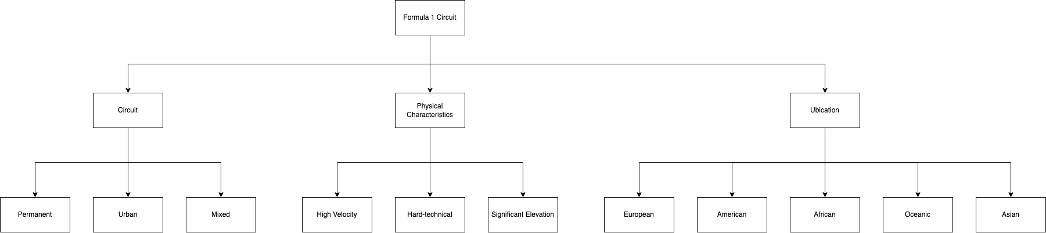
Circuits

Slide 18
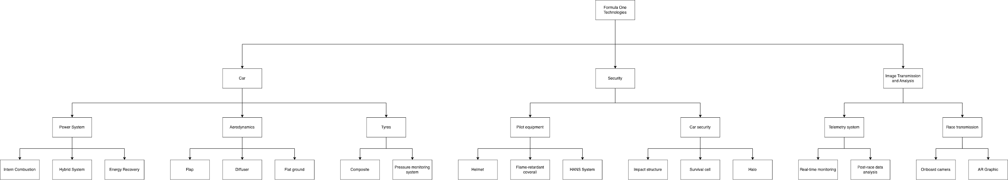
Technologies

Slide 19
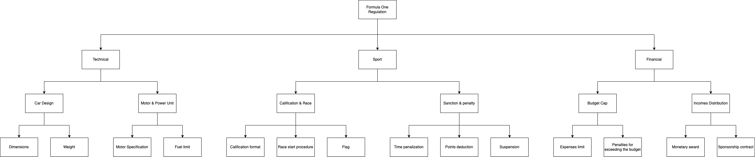
Regulations

Slide 20
Interactive Images
Metadata:
name: Bahrein
year_fundation: 2006
km: 2,1
description: It’s a circuit based in Asia with a…
lap_record: 2:10:05
record_pilot: Lewis Hamilton
video: source
photo: source
accidents: 23
latitude: 13º 13’ 23’’
longitude: 56º 9’ 12’’
capacity: 200.000
Taxonomy:
Permanent, Hard-technical, Asia. (taxonomy Circuit)
Formula 1
(taxonomy Sports)
Race
(taxonomy Events)
Low-level features:
We can detect this type of data analysing video clips and detecting when the shape is like a circuit and the contrast, because of always has the background in black and the circuit coloured depending on the sectors.

Slide 21
Videos
Metadata:
name: Gran Premio de España
start_date: 27/06/2024
video: source
photo: source
description: This gran prix is one of the oldest un F1, located in Barcelona…
Taxonomy:
Event, Race, Gran Prix.
(taxonomy Events)
Formula 1
(taxonomy Sports)
Classification
(taxonomy Events)
Low-level features:
To extract the most important clips of videos, for example the finish line, we have different algorithms that recognizes the finish line and take the video result.

Slide 22
Geolocations
Metadata:
name: Italy
city: Imola
Semantic Enrichment:
Circuits, Ubication, European.
(taxonomy Circuits)
Formula 1
(taxonomy Sports)
Low-level features:
We simply take all circuits and their locations directly from F1 databases every year. Using the premium API of F1, and we store that information.

Slide 23
Documents
Metadata:
name: R23
chasis_company: Renault
engine_company: Honda
engine: RS23
length: 4,3
width: 2,1
weight: 780,2
power: 870
Taxonomy:
Technical, Car Design, Dimensions
(taxonomy Technologies)
Technical, Motor & Power Unit, Motor Specification (taxonomy Regulations)
Low-level features:
We extract the most important and relevant information from all reports published by FIA and performed with a LLM to extract the relevant information

Slide 24
PART C

Slide 25
Documents
used
These documents could be:
FIA Regulations
Press Releases
Motorsport e-magazines
Reports
Interview transcriptions
Which documents we will use?
The Evolution of F1 Racing Engines
2023 F1 Teams and their Strategies
Legendary Circuits of the F1 World
F1 Race Day Dynamics
Regulatory changes in F1

Slide 26
Boolean Model: Document Matrix
Word | Doc #1 | Doc #2 | Doc #3 | Doc #4 | Doc #5
driver | 0 | 1 | 0 | 1 | 0
team | 0 | 1 | 0 | 1 | 1
circuit | 0 | 0 | 1 | 1 | 0
race | 0 | 1 | 1 | 1 | 0
engine | 1 | 1 | 0 | 0 | 1
aerodynamics | 1 | 1 | 0 | 0 | 1
tyres | 0 | 1 | 0 | 1 | 1
qualifying | 0 | 0 | 0 | 1 | 0
sprint | 0 | 1 | 0 | 1 | 1
championship | 1 | 1 | 0 | 0 | 0
podium | 0 | 0 | 0 | 1 | 0
regulations | 1 | 0 | 0 | 0 | 1

Slide 27
Boolean Model: Inverted Index
Word | Nº Docs | Total freq
driver | 2 | 2
team | 3 | 3
circuit | 2 | 2
race | 3 | 3
engine | 3 | 3
aerodynamics | 3 | 3
tyres | 3 | 3
qualifying | 1 | 1
sprint | 3 | 3
championship | 2 | 2
podium | 1 | 1
regulations | 2 | 2
Word | Doc # | Total freq
driver | 2 | 1
 | 3 | 1
team | 2 | 1
 | 3 | 1
 | 5 | 1
circuit | 3 | 1
 | 4 | 1
 | 5 | 1
Word | Doc # | Total freq
race | 2 | 1
 | 3 | 1
 | 4 | 1
engine | 1 | 1
 | 2 | 1
 | 5 | 1
aerodynamics | 1 | 1
 | 2 | 1
 | 5 | 1

Slide 28
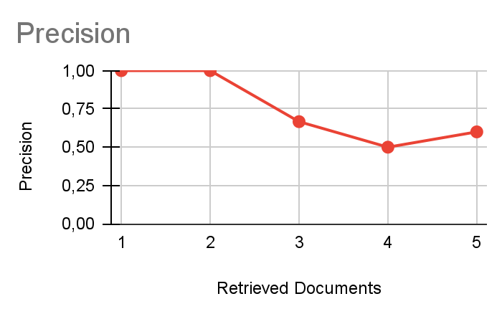
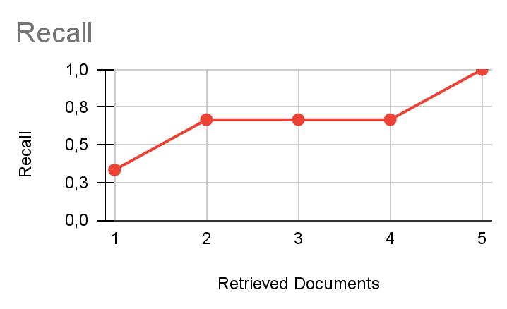
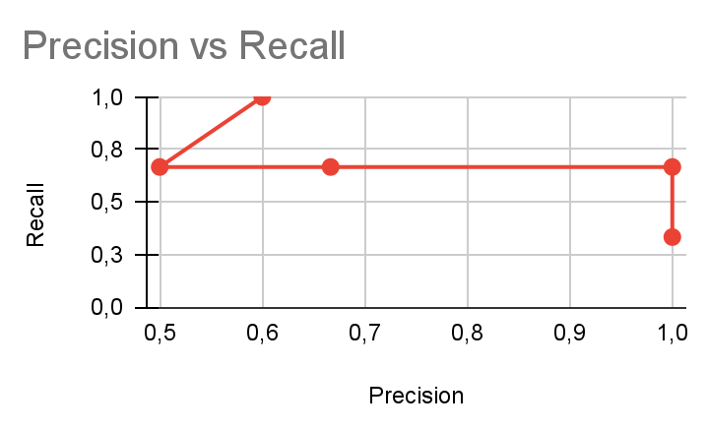
Boolean Model: Query 1
Query to find documents about car technologies:
ENGINE(11001) OR AERODYNAMICS(11001) = 11001

Slide 29
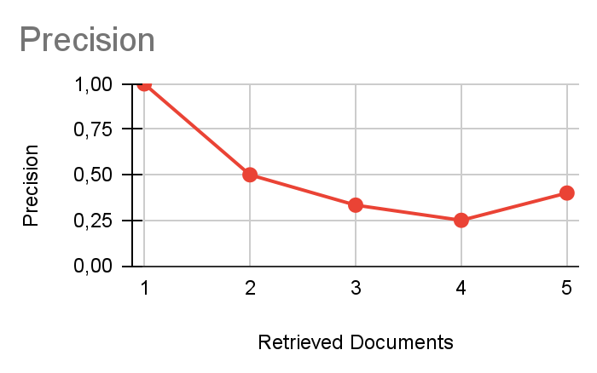
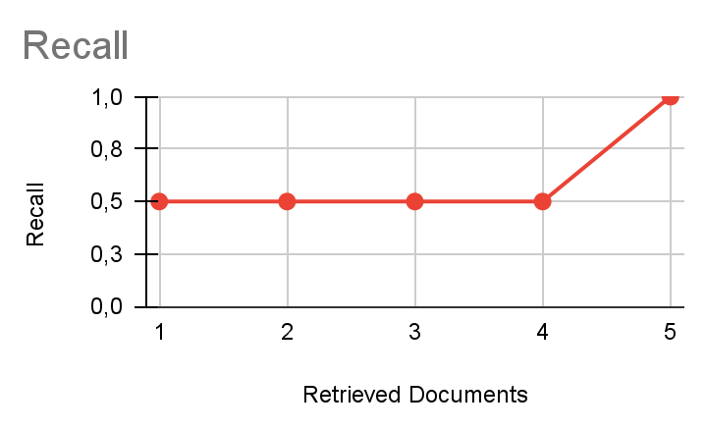
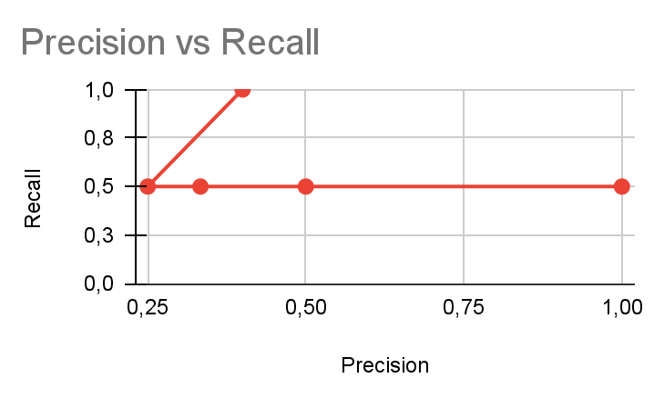
Boolean Model: Query 2
Query to get information about F1 regulations:
REGULATIONS(10001) AND (ENGINE(11001) OR AERODYNAMICS(11001) OR TYRES(01011)) = 10001 AND 11011 = 10001

Slide 30
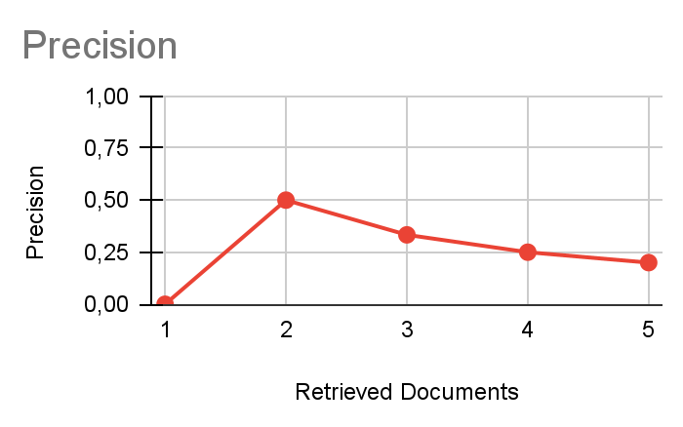
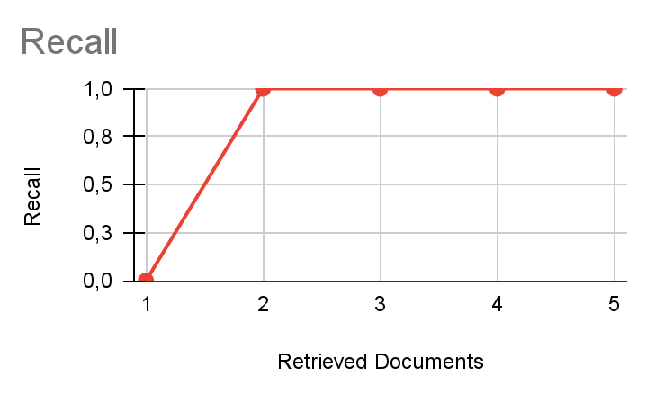
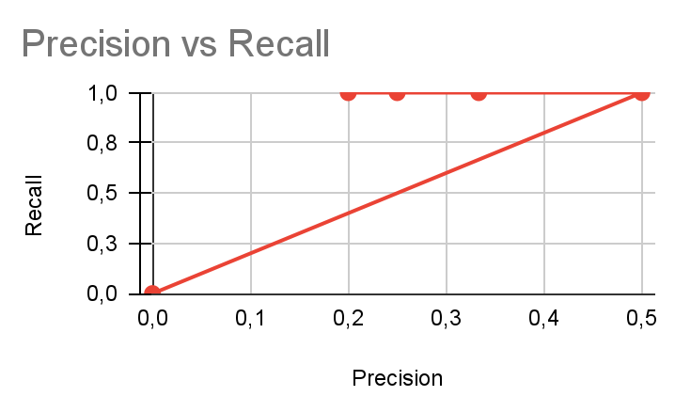
Boolean Model: Query 3
Query to get driver championships
DRIVER(01010) AND CHAMPIONSHIP(11000) = 01000

Slide 31
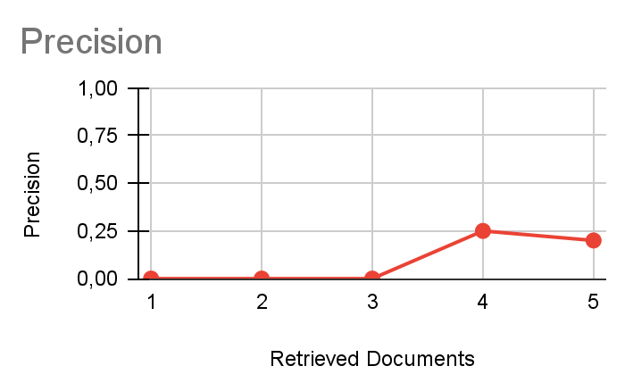
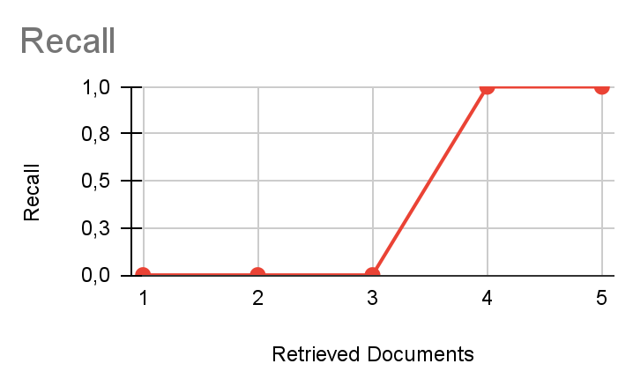
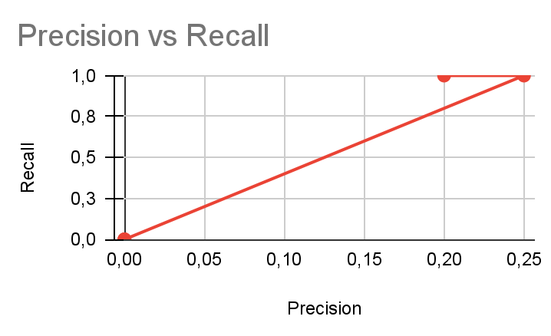
Boolean Model: Query 4
Query to know the podiums of a driver or a circuit
PODIUM(00010) AND (DRIVER(01010) OR CIRCUIT(00110)) = 00010 AND 01110 = 00010

Slide 32
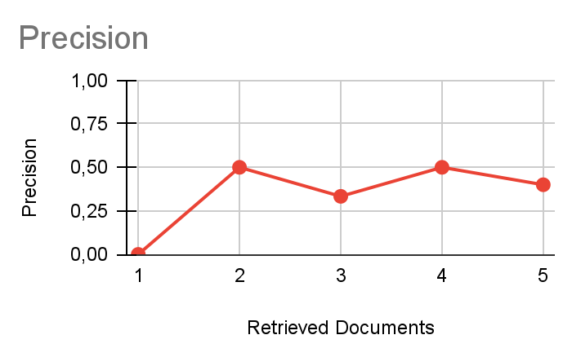
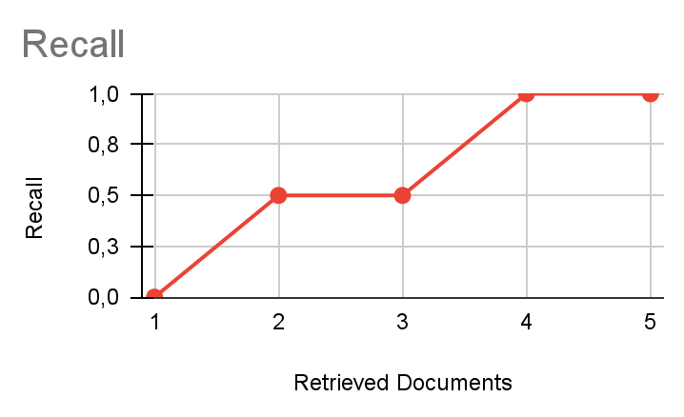
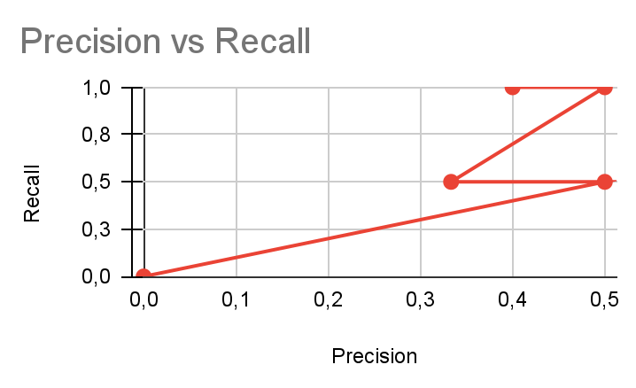
Boolean Model: Query 5
Query to know the tyres used of a driver in a circuit depending on the aerodynamics:
(CIRCUIT(00110) AND AERODYNAMICS(11001)) OR (DRIVER(01010) AND TYRES(01011)) = 0000 OR 01010 = 01010

Slide 33
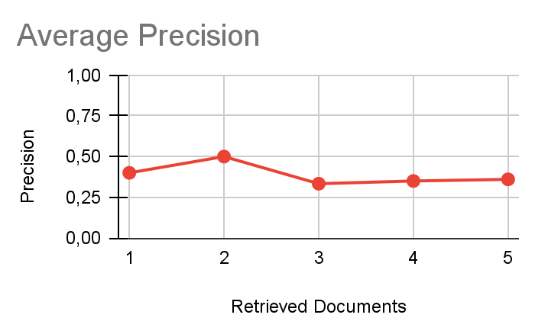
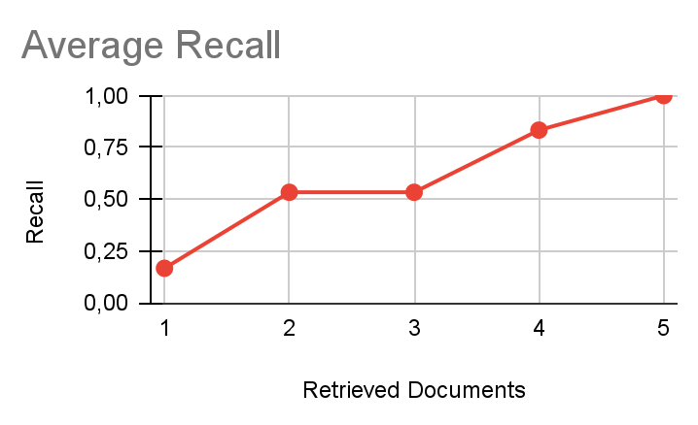
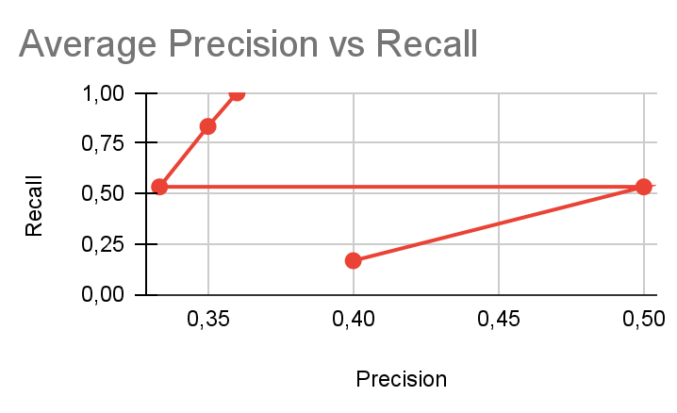
Plots: Averages of Precision and Recall
To see how we make all the calculus, see our spreadsheet here

Slide 34

Vector Space Model: How we calculate?
Where:
tf = Number of times that the word appears in the document / Number of words of the document
idf = Total number of documents / Number of documents that have the word
To see how we make all the calculus, see our spreadsheet here

Slide 35
Vector Space Model
Word | Doc #1 | Doc #2 | Doc #3 | Doc #4 | Doc #5
driver | 0,00 | 0,31 | 0,00 | 0,31 | 0,00
team | 0,00 | 0,56 | 0,00 | 0,56 | 0,75
circuit | 0,00 | 0,00 | 1,26 | 0,31 | 0,00
race | 0,00 | 0,56 | 2,25 | 0,56 | 0,00
engine | 1,13 | 0,56 | 0,00 | 0,00 | 0,75
aerodynamics | 1,13 | 0,56 | 0,00 | 0,00 | 0,75
tyres | 0,00 | 0,56 | 0,00 | 0,56 | 0,75
qualifying | 0,00 | 0,00 | 0,00 | 0,18 | 0,00
sprint | 0,00 | 0,56 | 0,00 | 0,56 | 0,75
championship | 0,63 | 0,31 | 0,00 | 0,00 | 0,00
podium | 0,00 | 0,00 | 0,00 | 0,18 | 0,00
regulations | 0,63 | 0,00 | 0,00 | 0,00 | 0,42

Slide 36
Query 1: Vector obtaining
Outcomes of the Query 1:
ENGINE(11001)
AERODYNAMICS(11001)
Query vector (Vq):
000011000000
Represents the presence of our vocabulary in the query
Word | Presence in Query of Doc #1
driver | 0
team | 0
circuit | 0
race | 0
engine | 1
aerodynamics | 1
tyres | 0
qualifying | 0
sprint | 0
championship | 0
podium | 0
regulations | 0

Slide 37
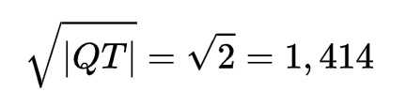
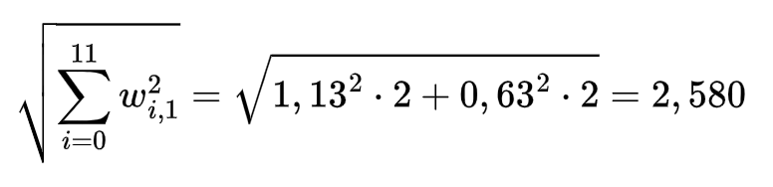
Query 1: Normalization
Normalization:
QT is the containing number of the index of 1s in our Vq
QT = {4, 5)
|QT| = 2
We will use the normalization factor:
Word | Presence in Query of Doc #1
driver | 0
team | 0
circuit | 0
race | 0
engine | 1
aerodynamics | 1
tyres | 0
qualifying | 0
sprint | 0
championship | 0
podium | 0
regulations | 0

Slide 38
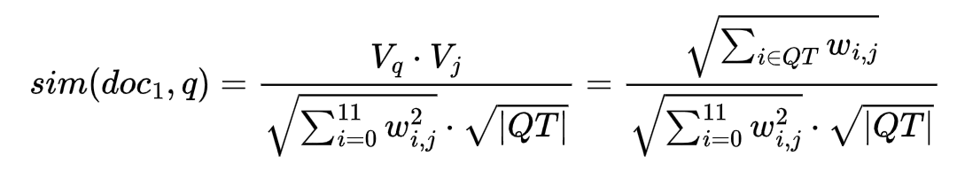
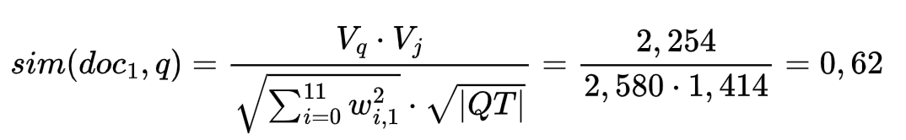
Query 1: Similarity
Similarity calculation:
Compute the similarity with Doc #1:
Vq = (000011000000)
V1 = (0, 0, 0, 0, 1.13, 1.13, 0, 0, 0, 0.63, 0, 0.63)
Vq * V1 = 1.13 + 1.13 = 2.26
Word | Doc #1
driver | 0,00
team | 0,00
circuit | 0,00
race | 0,00
engine | 1,13
aerodynamics | 1,13
tyres | 0,00
qualifying | 0,00
sprint | 0,00
championship | 0,63
podium | 0,00
regulations | 0,63

Slide 39
All queries: Similarity
Query 1
Doc #1 | Doc #2 | Doc #3 | Doc #4 | Doc #5
0,62 | 0,23 | 0,00 | 0,00 | 0,28
Query 2
Doc #1 | Doc #2 | Doc #3 | Doc #4 | Doc #5
0,558 | 0,246 | 0,000 | 0,153 | 0,354
Vector of query 1:
000011000000
Vector of query 2:
000011100001
Vector of query 3:
100000000100
Vector of query 4:
101000000010
Vector of query 5:
101001100000
Query 3
Doc #1 | Doc #2 | Doc #3 | Doc #4 | Doc #5
0,172 | 0,129 | 0,000 | 0,121 | 0,000
Query 4
Doc #1 | Doc #2 | Doc #3 | Doc #4 | Doc #5
0,000 | 0,053 | 0,281 | 0,253 | 0,000
Query 5
Doc #1 | Doc #2 | Doc #3 | Doc #4 | Doc #5
0,218 | 0,210 | 0,243 | 0,324 | 0,199

Slide 40
PART D

Slide 41
Global Features: Images
Circuit sectors: Each color of the circuit image represents a sector of it. To divide the circuit by sectors is interesting for f1 teams to improve statistics in localized parts.
Enumerated curves: Allows drivers, teams, commentators, and race officials facilitate clear and precise communication among the track.
Speed Trap: To know where is the fastest point of speed the circuit measured by radar technology.
DRS zones: Zones in which using DRS in enabled, which facilitates overtaking.
Use color segmentation to identify different colors in the image. This can help differentiate sectors, curves, high-speed parts, and DRS zones.

Slide 42
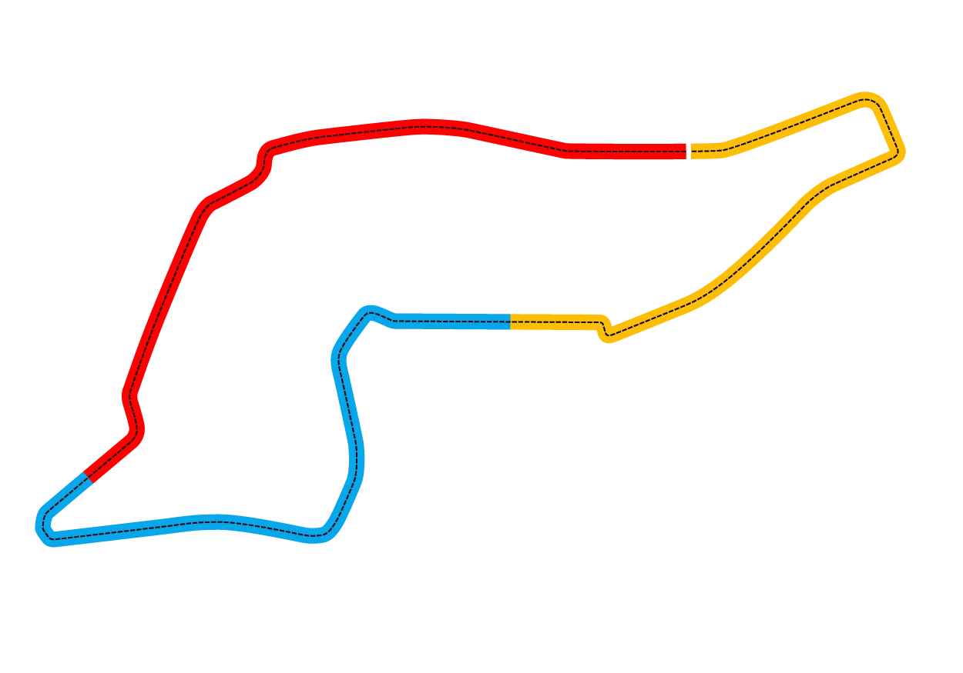
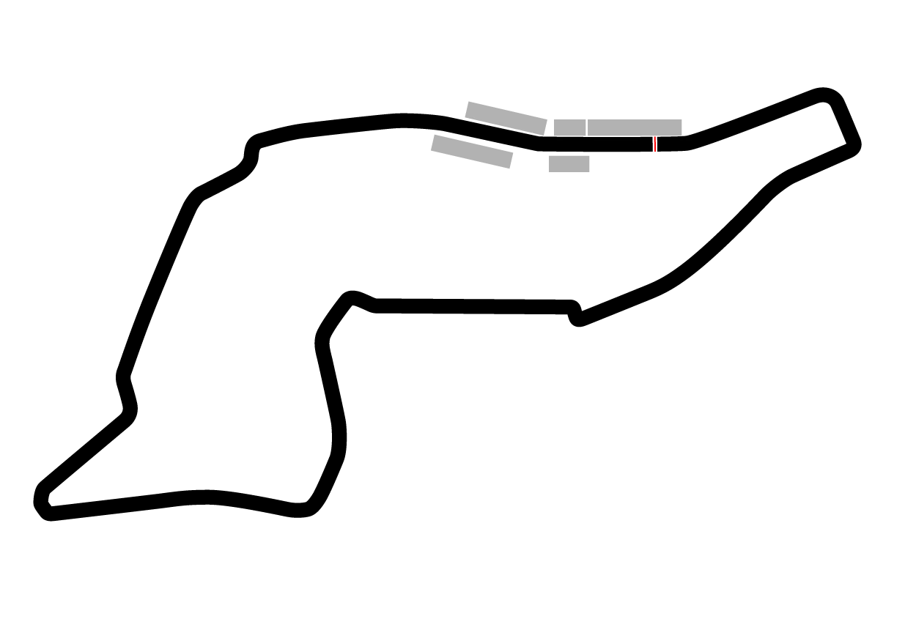



Local Features: Interactive Images
(Color Segmentation)

Slide 43
Global Features: Videos
Finish line recognition: In order to know in which order has the pilots arrived to the finish line and in which exact time they crossed it. This can be so useful to mark new records time and also to distinguish who arrived first in case of arriving so paired.
Motion analysis: identifying key events as accidents or analysing motion patterns like acceleration, braking or overtaking. In that way we can know where pilots are used to overtake.
Object tracking : to follow specific objects, such as cars, to know the tracks of each pilot.
Use Optical flow analysis to detect the car’s track and finish line arrival.
Optical flow is the pattern of apparent motion of objects, surfaces, and edges in a visual scene, caused by the relative movement between the observer (camera) and the scene.

Slide 44
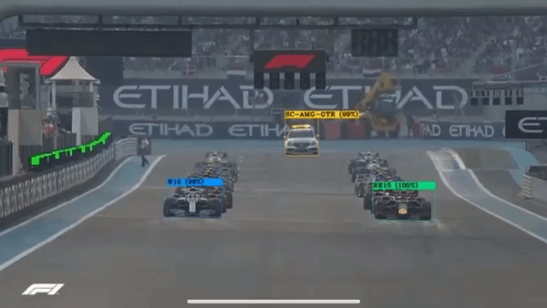
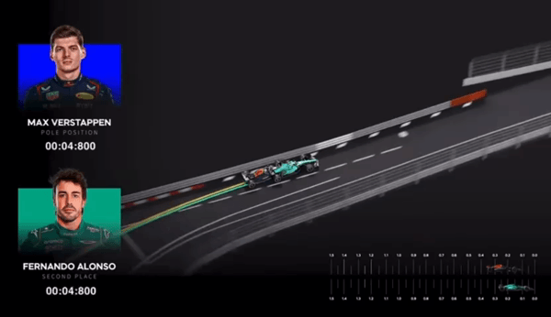
Local Features: Videos
In the context of an F1 race, Optical Flow can be used to recognize each car and scuderia by tracking their motion across video frames. By analyzing the movement paths of the cars, it can compare the different racing lines taken by the drivers, providing insights into their driving strategies and performance.

Slide 45
Global Features: Geolocations
Grandstands location: Allows f1 spectators to know where is the grandstand of the ticket they purchased in order to validate in the right place.
Points of interest: Allows users to know all the points of the circuit that can be useful for them like parkings, restaurants, wc and others.
Use a Geographic Information System (GIS) to digitize the map.
Use QGIS to get the map with specific feature
Use Dijkstra's pathfinding algorithm to find the fastest route from a user's position to a specific point.
Use Speed Estimation to estimate time from point A to point B.

Slide 46
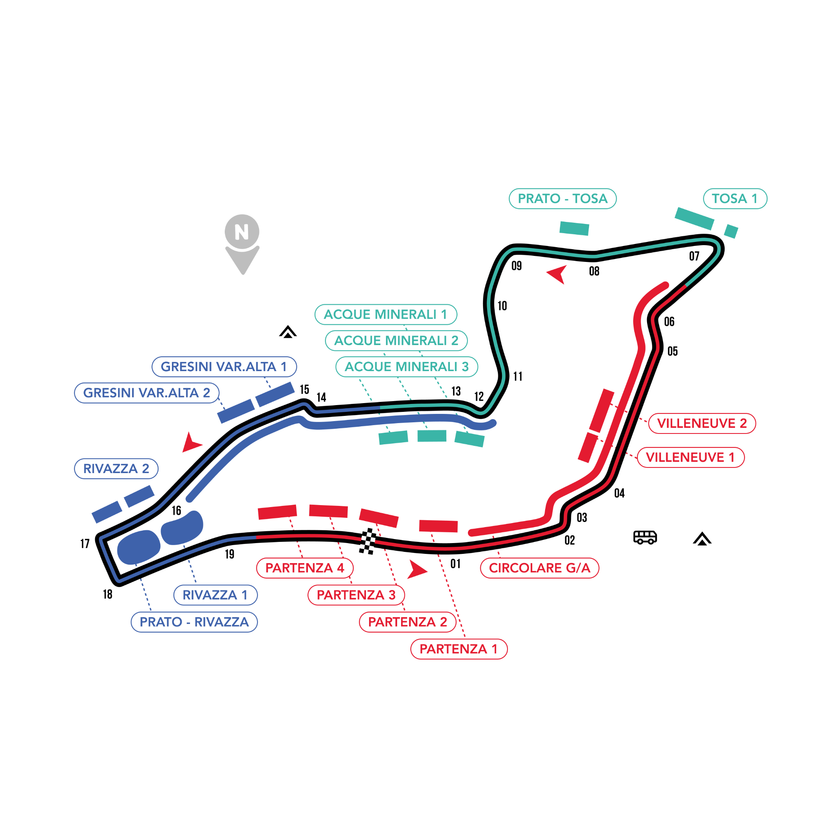
Local Features: Geolocations
(QGIS)
STEPS
Opened QGIS and loaded all the Data in.
Opened Attribute Table and Filtered Data by selecting with the expression:
"type" = 'grandstand'.
Exported the filtered Data, and loaded in to a new QGIS style layer in which Grandstands are highlighted.

Slide 47
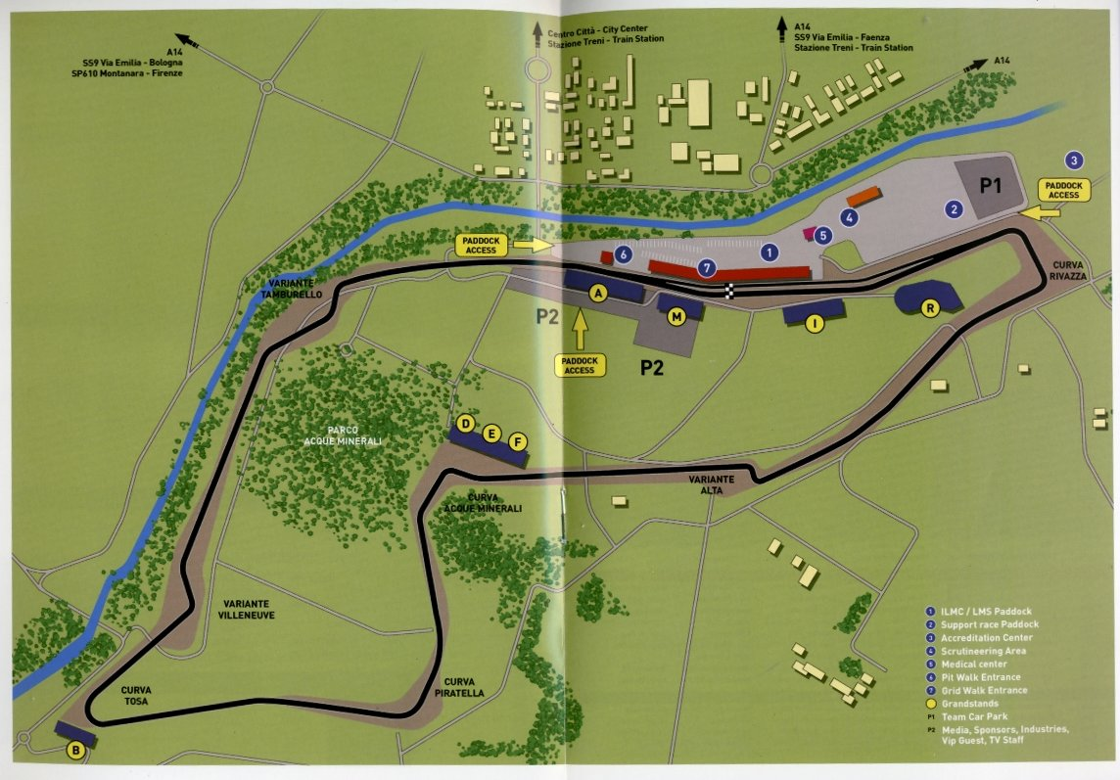
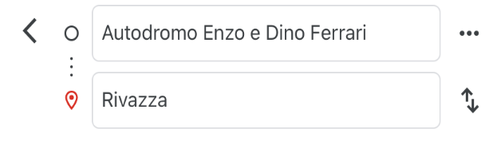
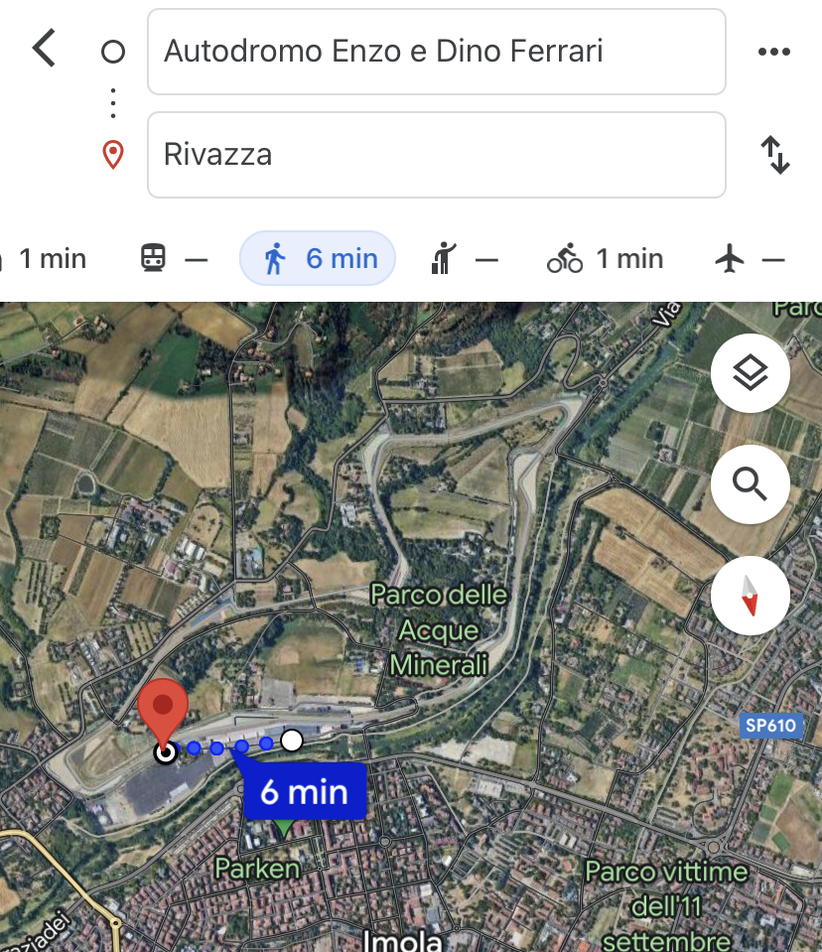
Local Features: Geolocations
(GIS)
(Dijkstra's pathfinding algorithm + Speed Estimation)

Slide 48
Global Features: Documents
Length of Document (Number of Words): The "length of a document" refers to the total number of words it contains. This metric is straightforward but critical in many aspects of text analysis and natural language processing.
Frequency of Words: The "frequency of words" refers to how often words appear in a text. This measure is fundamental in many NLP tasks:
Raw Frequency: Simply the count of how many times each word appears in a document.
Normalized Frequency: Often, the raw frequency is normalized by the length of the document (the total number of words) to provide a relative measure of importance. This helps in comparing the significance of words across documents of different lengths.
LDA (Latent Dirichlet Allocation): LDA is a type of probabilistic model specifically used for identifying the topic distribution within documents.

Slide 49


Local Features: Documents
Taking relevant documents
Embeddings for similarities
Question
Response: Relevant Documents

